Slide 1
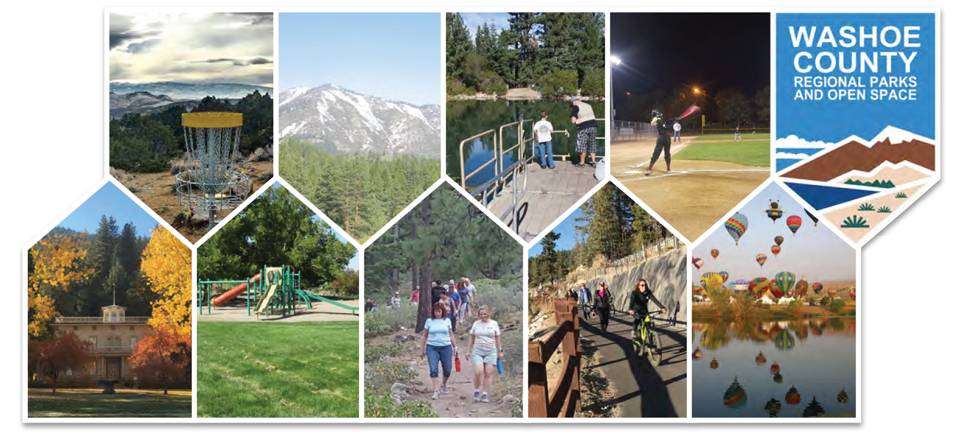
2019 Parks Master Plan

Slide 2
Commissioner Comments
  Formatting (legible text, table of contents, page numbers, etc.)
  Recognition and inclusion of all entities that collaborate with Washoe County Regional Parks and Open Space
  Specific comments related to the planning areas
  Ideas about what to include in the executive summary

Slide 3
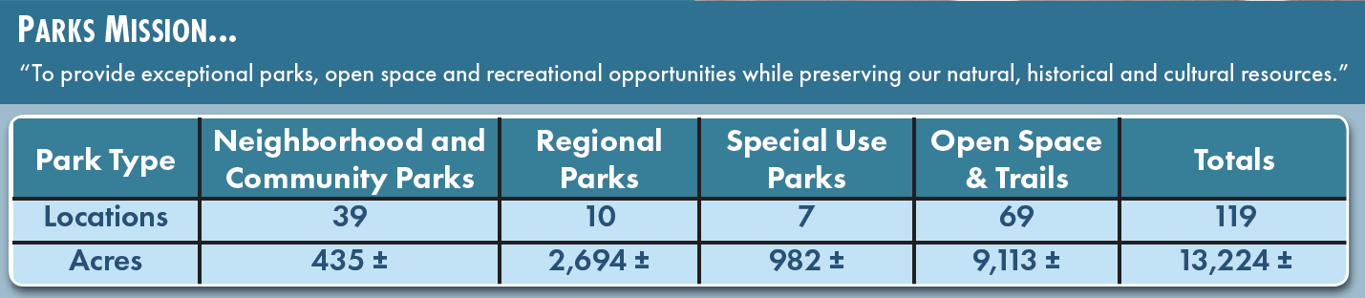
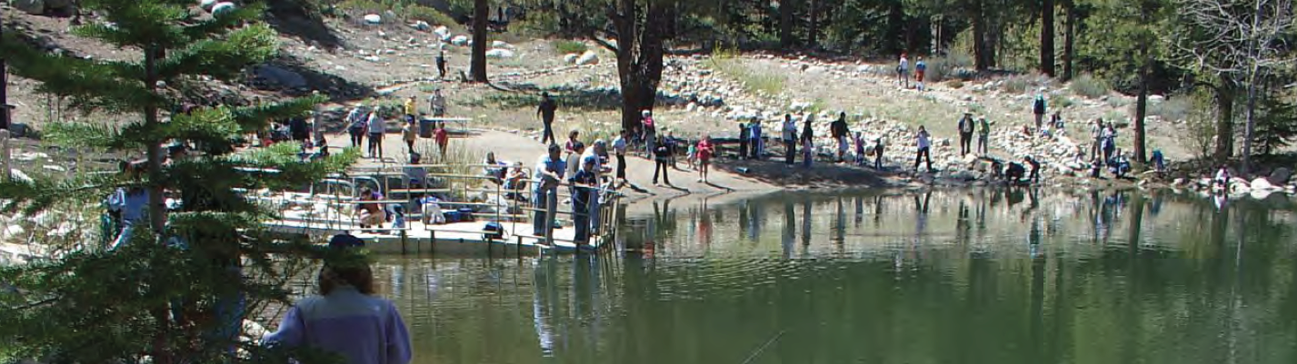
Executive Summary – Pages 1 & 2

Slide 4
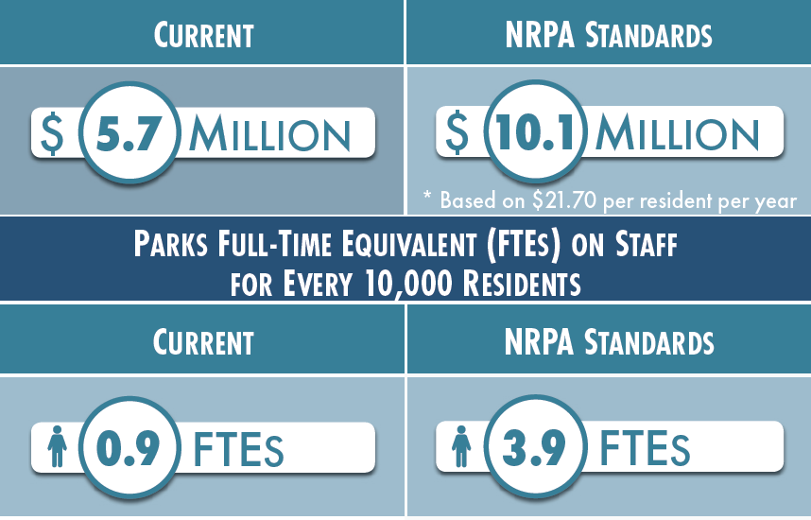
Executive Summary – Page 3

Slide 5
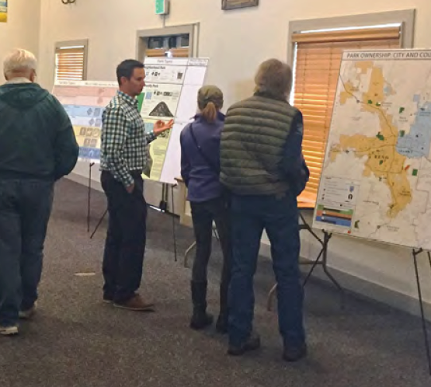
Executive Summary – Page 4
  Residents Want:
    Regional Parks
    Build Out Existing Park Master Plans
    Open Space Acquisition
  Residents Use:
    Hiking Trails
    Natural Areas/Open Space
    Multi-Use Paths

Slide 6
Executive Summary – Page 5
  Planning Area Opportunities:
    Build Out Regional Parks (Lazy 5, North Valleys, South Valleys, etc.)
    Utilize Reclaimed Water
    Acquire Open Space
    Provide Trail Connections
    Update Existing Park Facilities

Slide 7
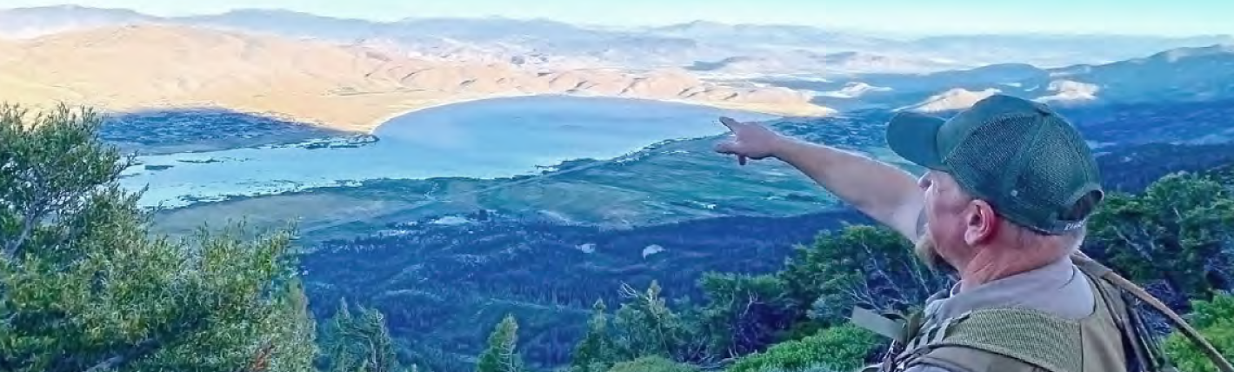
Executive Summary – Page 6
  Short-Term, Mid-Term and Long-Term Strategies

